Slide 1
Legal Analytics
Mentor : Mr. Animesh Tiwari
Group 1
Shraddha Ganesh Vispute
Prithvi Parihar
Harish Kumar
Arunava Nandy
Pradeep Vasan D
Monish Martin

Slide 2
Problem Definition
- The project aims to employ Legal Analytics in order to predict the winning party given the case details
- The primary objective of a Law Firm is to argue cases where chances of success is high.
- Appropriate analysis and Machine Learning models aid a firm or a lawyer to make an informed choice based on historical data and sound statistical analysis.
- Given the details of a case, the law firm will be able to predict the outcome which shall enable the agency to maintain a better track record and select cases where the chances of winning are high.

Slide 3
Dataset Considered
The database used dates back to the year 1946 during the beginning of Vinston Court and Warren Court. There have been many versions since then.
The data involves case details dated from 1946 to 2019.
Thus with increase in information, the needed responsibility to alter/ transform the data is carried out
The dataset consists of 61 columns and 80845 records.

Slide 4
Complexity Involved
Find the key area, gaps identified in the topic survey where the project can add value to the customers and business.
Dataset includes a large number of records, hence the necessary imputation and transformation requires in-depth understanding of the data.
Finding out the best target variable as the dataset contained multiple potential target variables.
Certain predictor variables involve information that a law firm may not have access to. They need to be identified and removed.

Slide 5
Solution Path
Obtain resourceful data that enhances the understanding of the business problem and also aids in model building.
Split Data into Train and Test
Representation of Train and Test on original data
Null value Imputation
Check Multicollinearity using Cramer’s V test
Feature Removal [ Information based ]
Feature Engineering [ Duration of a case ]
Perform Appropriate EDA to determine those columns that shall be critical in predicting the outcome of a case given the details for the same.
Perform statistical tests to determine the influence of predictor variables on target variable.
Model Building
Model Evaluation

Slide 6
Data Study
The dataset contains 61 independent features and eighty thousand plus records
Each feature is studied extensively to aid the process of data cleaning.
Identification of categorical and numerical features and their distribution.
Identify defects in dataset [ features having null values greater than 85% ]
The dataset has multiple target variables. The final target variable chosen is Winning Party.
Case identification features such docket id is removed.
The Target variable has 3 classes with one rare label. This rare label is removed. [class 2 ]

Slide 7
Train Test Split
The dataset is split into train and test before any important process such as data cleaning or EDA. This is done to avoid data leakage.
Hypothesis test is also performed to check if Ytrain and Ytest represent the original data Y.
The dataset is split into train and test with 60 :40 ratio.

Slide 8
Null Value Imputation
Hot Deck Imputation is performed for this dataset.
The dataset is split into two. One where the target class is 1 ( favourable judgement) and the other where target class 0 ( unfavourable judgement )
Two mode values are calculated for the same.
Now when a null value has to be imputed, the target variable is checked first.
Based on the class [1 or 0], the appropriate mode value is imputed.
The Null value imputation is performed separately for Train and test dataset to avoid data leakage.

Slide 9
Multicollinearity
Pearson’s correlation coefficient cannot be used to check multicollinearity as the features are all nominal in nature.
Hence an appropriate test is used to check the association between the predictor variables.
We use the Cramer’s V test.
The value ranges between 0 and 1
Issue and IssueArea seem to have perfect association. This is because Issue is a subcategory of IssueArea. Hence the feature “issue” is removed.
The features lcDispositionDirection and ThreeJudgeFdc also show moderate association. These features will be removed later as a result of a chi square test.

Slide 10
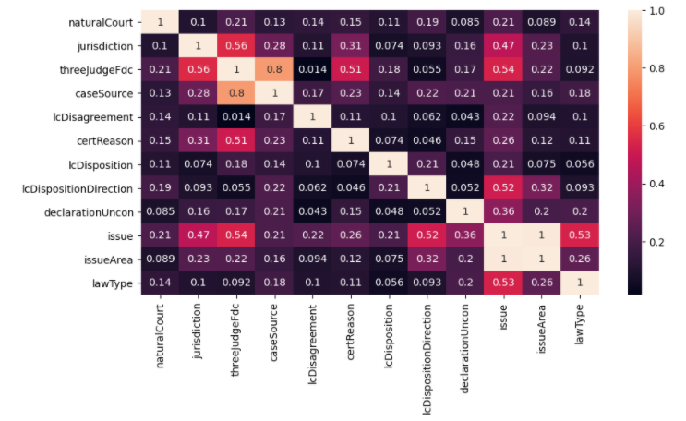

Slide 11
Feature Removal [ Information Based ]
The US Supreme Court dataset includes information about the judgement passed by the apex court such as decisionType and decisionDirection
These features may not be available to the business / Law firm while looking at a new case. Information such as duration of a case is available only after the case has been closed. Hence a law firm may not have access to such information.
Such Features are removed from the model building process.

Slide 12
Feature Engineering - Duration of a case
The duration of the case is calculated using the independent features dateDecision and dateArgument.
The variable cannot be used in the process of model building, but it can be used to find insights, if any, with our dataset.
The distribution plot indicates that most cases are completed within 100-200 days.
A Hypothesis test is conducted to understand if the duration of a case has any influence on the target variable.
A Mann-whitney U test is conducted as the samples are non-parametric in nature.
The p value obtained is greater than 0.05 and hence the null hypothesis is accepted.
A box plot is also visualized for the same.

Slide 13
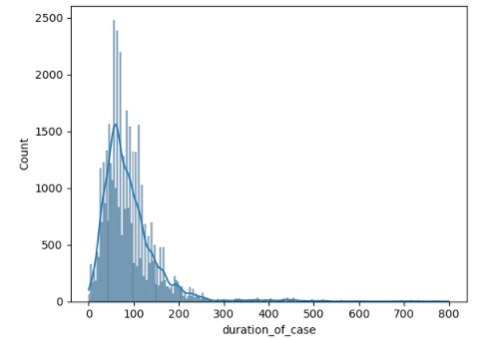
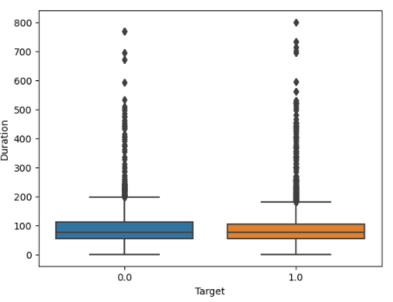

Slide 14
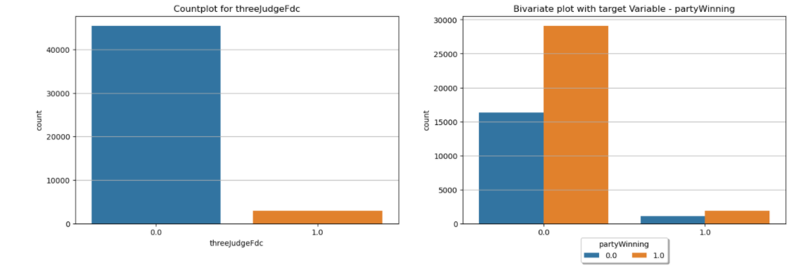
EDA
Appropriate Plots are used to visualize univariate and bivariate relationships between predictor variables and target variable.

Slide 15
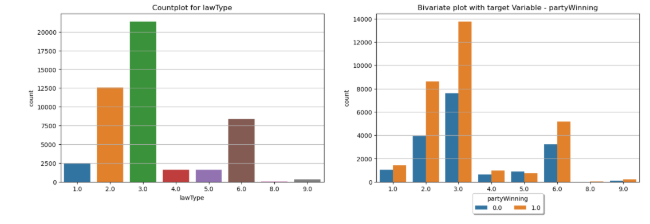
EDA

Slide 16
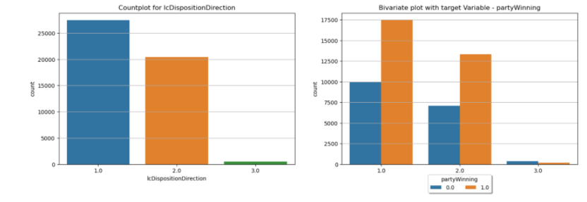
EDA

Slide 17
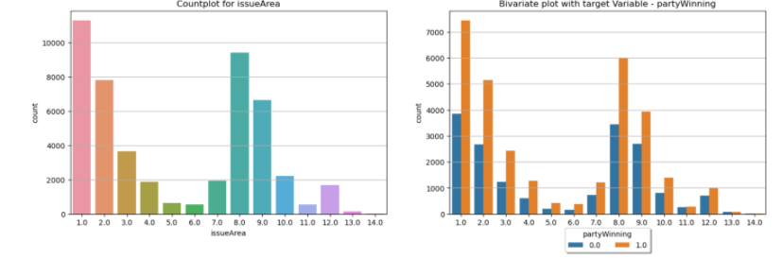
EDA

Slide 18
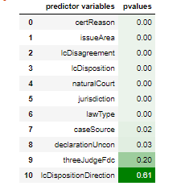
Statistical tests
A chi square test is performed between the predictor variables and the target variable.
The features threeJudgeFdc and lcDispositionDirection is removed.
Once the features are removed, the multicollinearity also reduces in the dataset. This is verified using the Cramer’s V test.

Slide 19
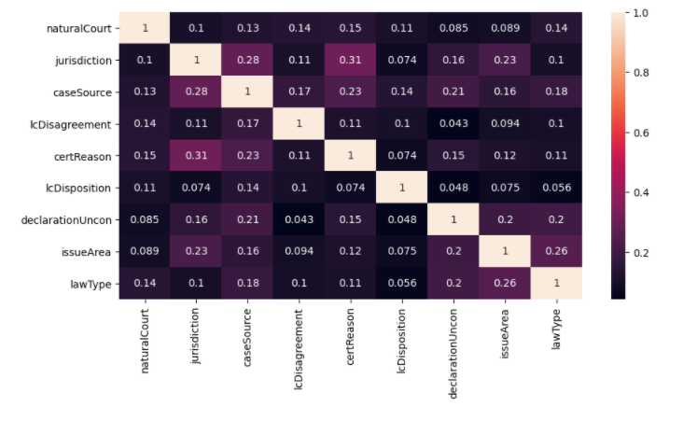

Slide 20
Model Building
The data has now been condensed to 9 predictor features that are critical in determining the outcome of a case.
2 base learners and 4 Ensemble techniques are used for model building.
Logistic Regression, Decision Trees, Random Forest, AdaBoost Classifier, Gradient Boosting Classifier, XGBoost Classifier.

Slide 21
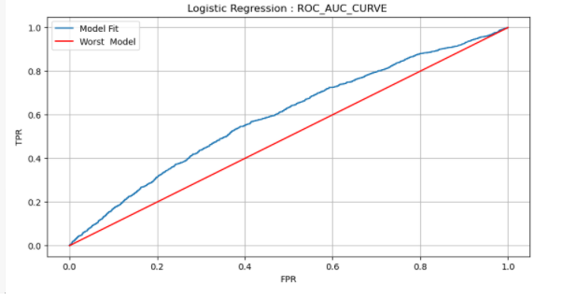
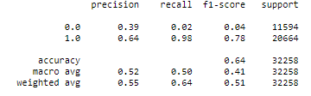
Logistic Regression
Logistic regression is a generalized linear model (GLM) and hence it works on the fundamentals of Linear regression.Since most of our data is categorical, it does not perform well.
ROC_AUC_SCORE : 0.59

Slide 22
Decision Trees
Decision Tree / Tree based algorithms are one of the best solutions for the dataset involving case details. A tree based algorithm provides any business / Law firm a clear decision path to determine if the petitioner will get a favourable judgement based on the case details.
There is a considerable increase in metrics such f1 score, precision, roc_auc_score and recall.
The classification report and the ROC_AUC_CURVE also shows that the models are capable of predicting both Target class 1 and Target class 0 with decent accuracy.
ROC_AUC_SCORE : 0.88

Slide 23
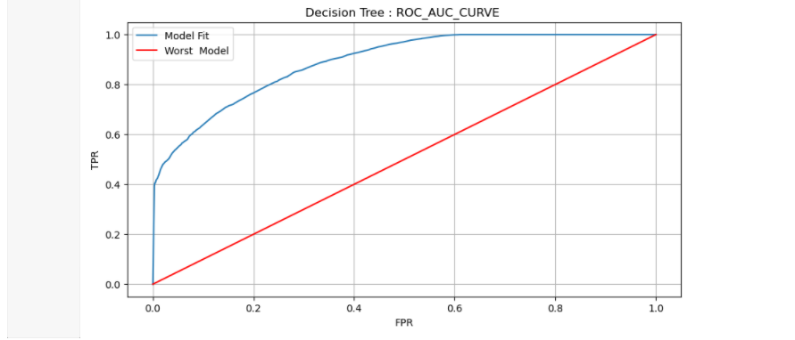
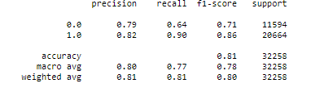

Slide 24
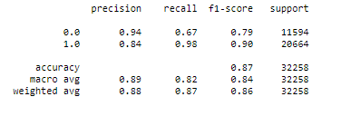
Random Forest
Random Forests work on the basis of Bootstrap sampling Algorithm and random selection of features at each split.
Random Forests are one of the most accurate algorithms which provide excellent accuracy. This is especially so when the dataset used for training is large.
The ROC_AUC curve shows that the TPR value remains constant even though the value of FPR decreases, This is ideal for any machine learning model.
ROC_AUC_SCORE : 0.95

Slide 25
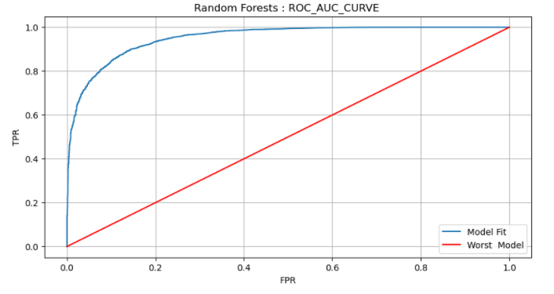
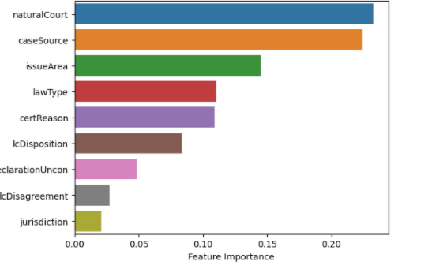

Slide 26
AdaBoost Classifier
AdaBoost is one of the first boosting algorithms to be adapted in solving practices
Though AdaBoost employs a boosting algorithm, the base learners present in the model are weak as the max depth is 1 for all base learners. This hinders the model from learning the complete relationship between independent and dependent features.
The ROC_AUC curve also shows a minimal increase ( with respect to Logistic Regression ) in the ROC_AUC_SCORE (0.65). Though the model does not provide best results, it is useful to understand the working of a Boosting algorithm.

Slide 27
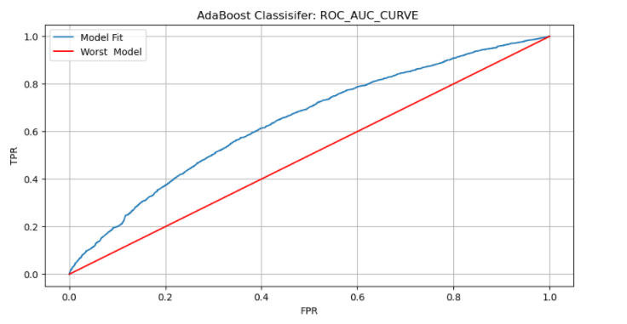
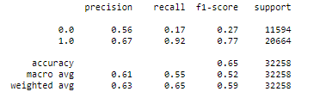

Slide 28
Gradient Boosting Classifier
Gradient boosting doesn’t modify the sample distribution. Instead of training on a new sample distribution, the weak learner trains on the remaining errors (called pseudo-residuals) of the strong learner.
The only disadvantage with this approach is that it is difficult to interpret and is prone to overfit the training data.This technique is superior to the process used in building an AdaBoost classifier model.
This is verified as the model performance increases when compared to the AdaBoost Classifier Model. The classification report shows a decent F1 score. The ROC_AUC_SCORE obtained is 0.75

Slide 29
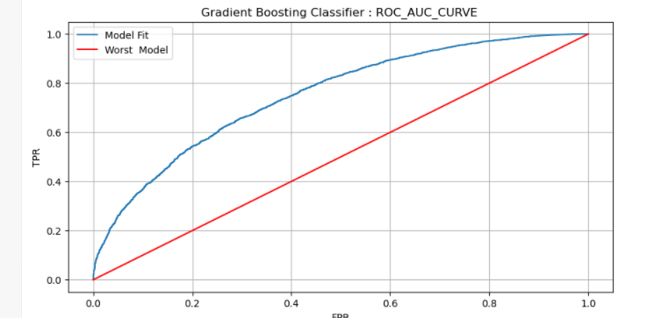
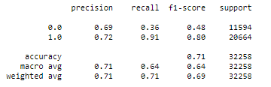

Slide 30
XGBoost Classifier
Approximate Greedy Algorithm [ Parallel Learning and Weighted Quantile Sketch ]
Sparsity Aware Split for missing values
Built In cross validation
Cache Aware Access
Regularization
XGBoost classifier shows that Machine Learning models can be much more than applied statistics. The dataset used for the project has more than eighty thousand records. This makes it ideal for ensemble techniques such as Random Forest and XGBoost classifier.
XGBoost (Extreme Gradient Boosting) is an optimized distributed gradient boosting library. It uses a gradient boosting (GBM) framework at its core. Yet, it is better than the GBM framework alone. Serves the purpose of Generalization and Reduction in error.

Slide 31
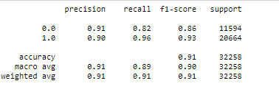
F1 score represents the harmonic mean of two classification metrics - Precision and Recall.
The classification report generated for the XGBoost classifier shows a good f1 score for both target class 1 and 0. This means that the algorithm has separated the 2 classes efficiently in the model building process.
In all the previous mentioned algorithms, the f1 score for target class 0 was always lesser by a good measure. But the XGBoost classifier provides a balanced and efficient prediction of both target classes

Slide 32
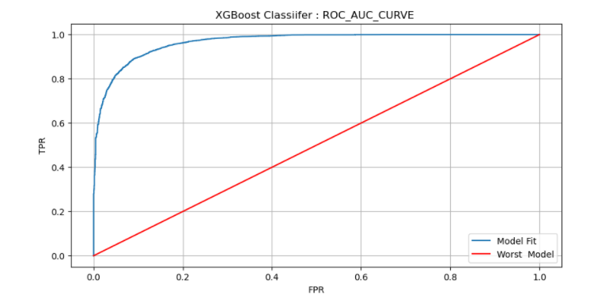
If the classes 1 and 0 are separated well, the TPR value will remain constant despite constant decrease in FPR. We can see that our model shows constant TPR even though the False Positive Rate reduces consistently. This indicates a high ROC_AUC_Score. The XGBoost model produces a score of 0.96, which is the highest of all classification algorithms used in this project.

Slide 33
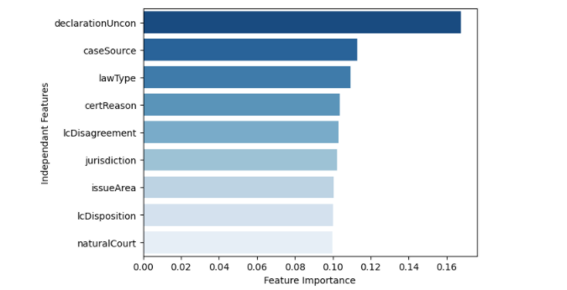
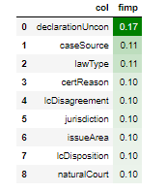
The feature importance values are shown graphically using a bar plot. DeclarationUncon, Case Source and Law Type seem to be the features that contribute the most.

Slide 34
Hyper Parameter Tuning
Both Randomized Search CV and Grid Search CV were implemented for GBM with XGBoost with small hyper parameter set.
The results did not change much with an increase of 0.25 in ROC_AUC_SCORE.
The process of Hyper parameter tuning is both time and computer resource exhaustive and hence was done in a minimal fashion

Slide 35
Model Evaluation
A 10 Fold Cross validation process is used to obtain values of both ROC_AUC_SCORE and accuracy for each model.
The values for each model are then converted into boxplots.
The plot below visualizes the variance in performance for each machine learning model used in this project.
Logistic Regression and AdaBoost classifier provides the worst results among six classifiers.
Relatively the variance is higher in these two algorithms with lesser scores.
Gradient Boosting Algorithm and Decision Trees provide decent results with occasional outliers.
Random Forest and XGBoost provide the ROC_AUC scores with minimum variance. The minimum variance is an indicator that the model is consistent at delivering good results.

Slide 36
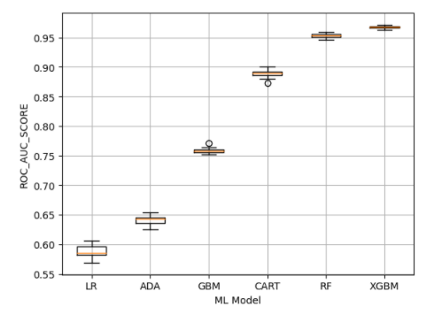
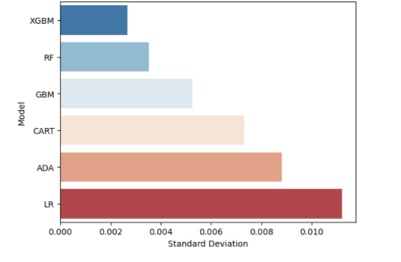
ROC_AUC_SCORE

Slide 37
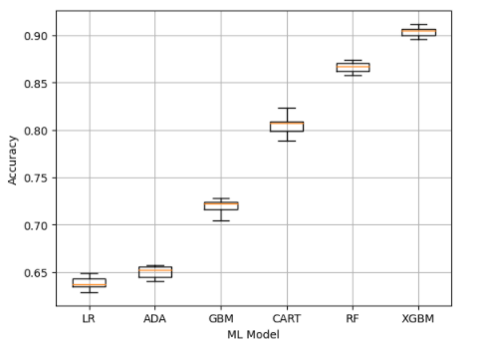
Accuracy Score

Slide 38
Time taken to fit model
The amount of time taken to build a model and its performance can be compared.
We can see that the Gradient Boosting classifier takes the highest amount of time to finish the task.
Random Forests are able to complete the same with a lesser amount of time.
The Highlight of the graph is the time taken by the XGBoost model. As discussed earlier, the model handles large datasets well. Thus the XGBoost Classifier Algorithm completes the task in less than half the time taken by GBM. The Standard Deviation in model performance can be visualized using a horizontal bar chart
The time taken for a model to fit over a 10 fold cross validation process is visualized

Slide 39
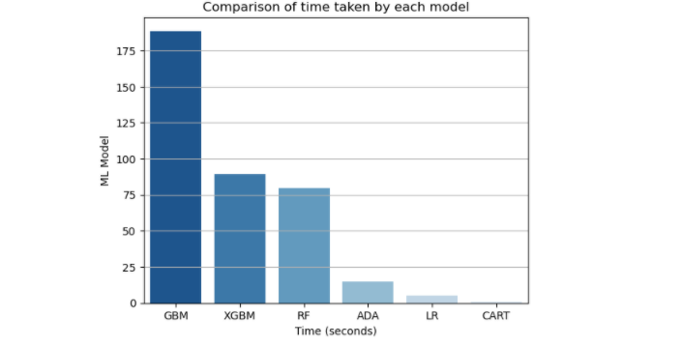

Slide 40
Conclusion
Considering a business model, Legal Analytics can be widely used by private or government law firms to actually predict the outcome of a particular case, whether the outcome would be 1 ( In favour of the Petitioner) or 0 ( Not in favour of the Petitioner) provided the information is with them.
The necessary steps required to implement a Machine Learning and Data science project has been successfully executed.
Further developments based on clustering can be done to produce recommendation systems based on the dataset.

Slide 41
Thank You!

